Slide 1

Machine Learning
Final presentation
Group 9
Bryan Van Huyneghem – Anoek strumane

Slide 2


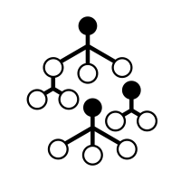


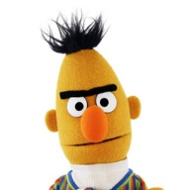
Table of contents
Sprint 1
Exploratory Data Analysis (EDA)
Data Pre-processing & Cleaning
Supervised Learning Algorithms: SVM and RF
Sprint 2
Finding a different classification
Exploring new word embedding methods (Doc2Vec)
Unsupervised Learning Algorithms: K-Means, DBSCAN, K-Medoids
Sprint 3
Additional pre-processing
Unsupervised Learning Algorithm (Topic Modelling): LDA
Supervised Learning Algorithm (Deep Neural Network): BERT

Slide 3

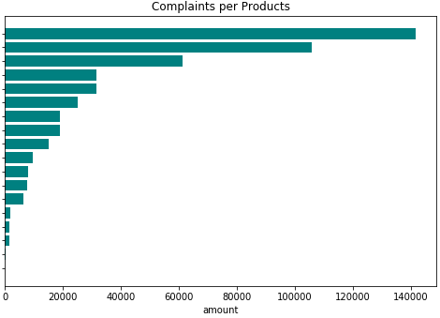
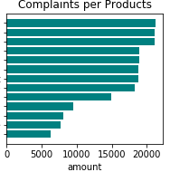

EDA
Imbalanced dataset
… still not perfect, but slightly better.
More improvements throughout sprints.

Slide 4

Other issues:
Scarce data for some products
Unique columns / General columns
Narratives: need to be cleaned…
Removed complaints about certain products (== balancing)
Removed unique columns / General columns
Cleaned narratives

Slide 5

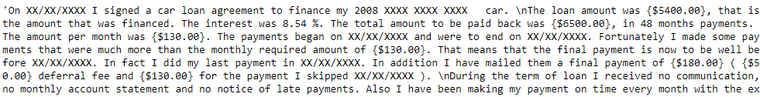
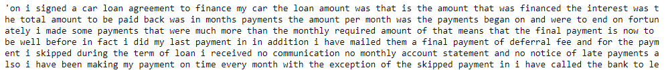

Data Pre-processing & Cleaning
Cleaning
Lemmatization
Removing plurals, conjugations → smaller BoW

Slide 6
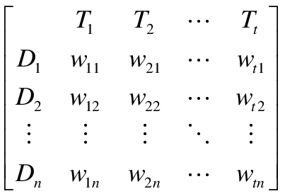
Complaint
CountVectorizer
TF-IDF
Dimensionality Reduction
Document-Term Matrix

Slide 7

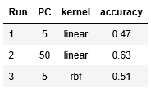
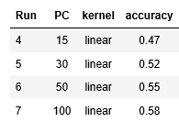
Results with SVM: narrative only
Unbalanced dataset (as an experiment)
Balanced dataset

Slide 8
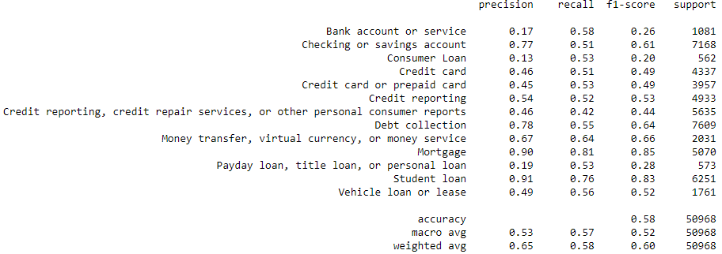
Results with SVM: narrative only
Still not
balanced
enough.

Slide 9
Results with SVM: adding issue
Principal components: 20
Narrative cleaned → 0.98 avg. model accuracy
Products balanced → 0.96 avg. model accuracy (less guessing)
Removing products that rarely occur → 0.96 avg. model accuracy

Slide 10
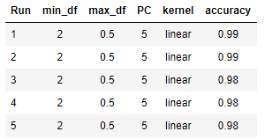
Results with SVM: adding other columns
Principal components: 5
Narrative + issue + …
Run 1: Sub-issue
Run 2: issue & sub-issue in one column
Run 3: State
Run 4: ZIP-code
Run 5: Company
Observations:
Thus, minor improvement (+3%) noticeable by adding one more column.
PC of 5 is already enough to yield great results.

Slide 11
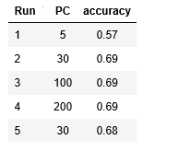
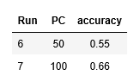
Results with RF: narrative only
Unbalanced dataset (as an experiment)
Balanced dataset
… without lemmatization
… with lemmatization
… lemmatization did not improve model.
… noticeable improvement when doubling PC.

Slide 12
Results with RF: adding issue
Principal components: 20
Narrative cleaned → 0.98 avg. model accuracy
Products balanced → 0.95 avg. model accuracy (less guessing)
Products balanced a second time → 0.94 avg. model accuracy (less guessing)

Slide 13
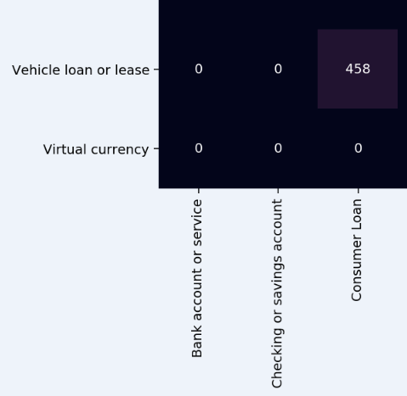
Confusion matrix (part of)
Part of the confusion matrix for the run where products were balanced twice
(avg. accuracy 0.94)
← ‘loan’ & ‘loan’

Slide 14
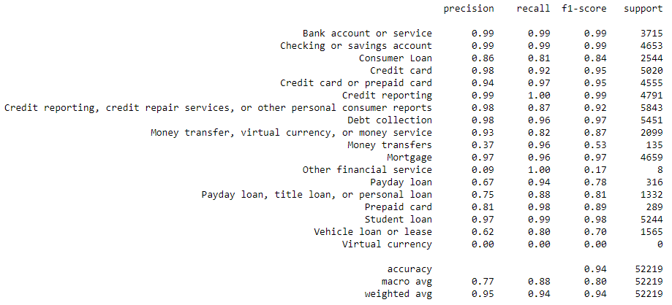
Classification Report of the same run

Slide 15
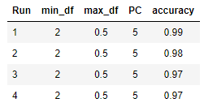
Results with RF: adding other columns
Principal components: 5
Narrative + issue + …
Run 1: Sub-issue
Run 2: State
Run 3: ZIP-code
Run 4: Company
Observations:
Thus, minor improvement (between 3 & 5%) noticeable by adding one more column.
PC of 5 is already enough to yield great results.

Slide 16
Conclusion
Possible improvements
Try other word embedding technique (e.g. Doc2Vec).
More cleaning and data balancing.
Use additional methods to measure performance (such as ROC).
Observations
SVM and RF matched in results with multiple columns, but RF > SVM in narrative only.
High avg. accuracy when combining narrative & issue.
2-5% avg. accuracy increase when adding a second column, e.g. Sub-issue or Company.
Worth it?
Macro avg. precision could increase if there would be a way to address problems with ‘loan’ products.

Slide 17
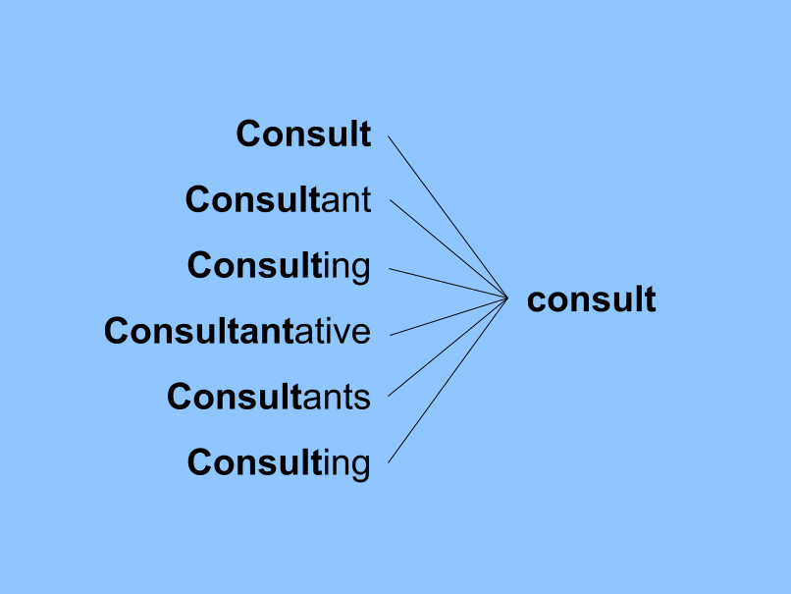
Sprint 2: unsupervised learning
Finding a different classification
Exploring new word embedding methods (Doc2Vec)
Unsupervised Learning Algorithms: K-Means, DBSCAN, K-Medoids
→ Do not use target; clustering algorithms (k clusters)
Addition cleaning & balancing done, incl. stemming instead of lemmatization

Slide 18
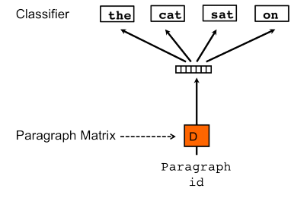
Doc2Vec: Representation of the narrative
Different word embedding: Doc2Vec (DBOW variant)
Tagged Document
Build Vocabulary
Observations:
Possible improvement: fine-tune hyper parameters for Doc2Vec.
Here: followed the recommendations by Lau and Baldwin.

Slide 19

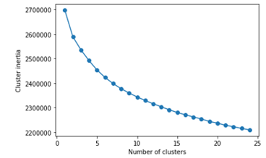
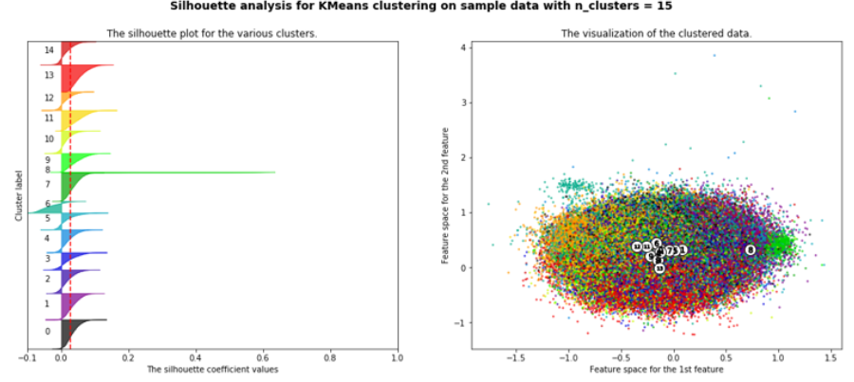
Results with K-Means
Unbalanced data set

Slide 20
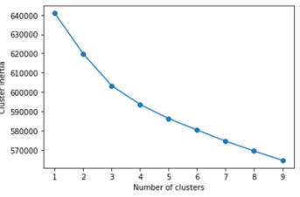
Results with K-Means
Unbalanced data set
Balanced data set

Slide 21
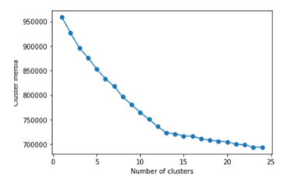
Results with K-Means
Unbalanced data set
Balanced data set
Runs containing ‘product’

Slide 22
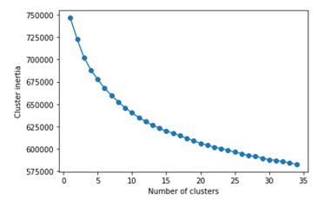
Results with K-Means
Unbalanced data set
Balanced data set
Runs containing ‘product’
Runs not containing ‘product’

Slide 23
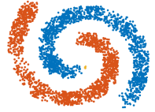
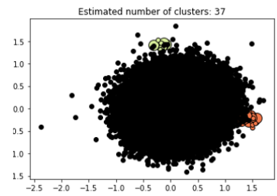
Results with DBSCAN
Balanced data set: ε = 0.7 min_samples = 100

Slide 24
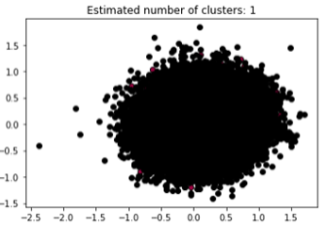
Results with DBSCAN
Balanced data set: ε = 2 min_samples = 100

Slide 25
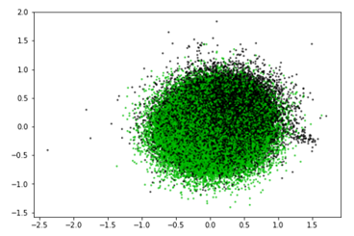
Results with K-Medoids
Balanced data set

Slide 26
Possible improvements
Dimensionality Reduction
Better Visualisation
Higher k-value
Show examples of narratives in different clusters

Slide 27
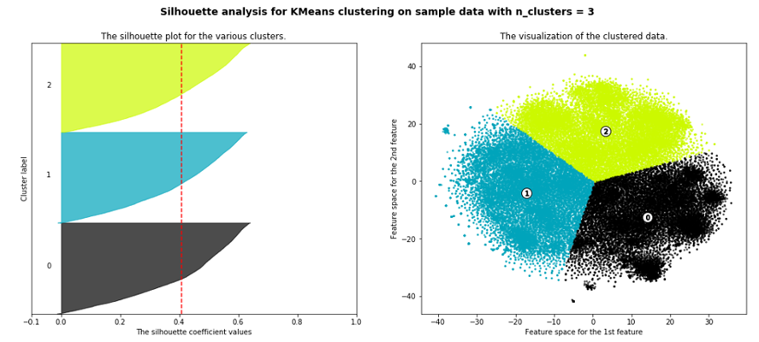
K-Means with improvements: T-SNE
Narrative only

Slide 28
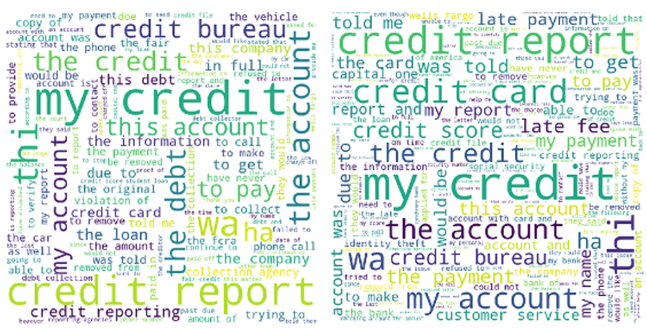
K-Means with improvements: T-SNE
Narrative only

Slide 29
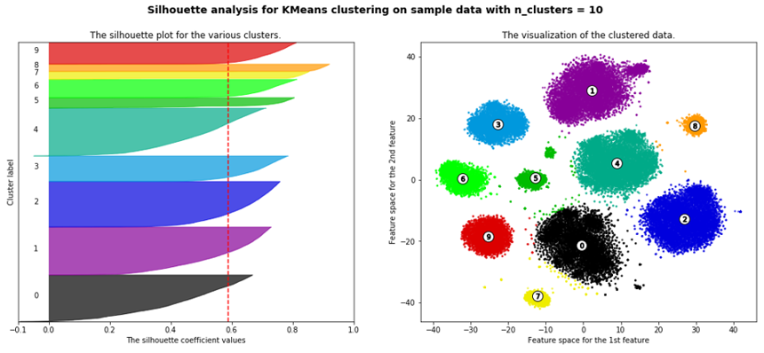
K-Means with improvements: T-SNE
Narrative and Product

Slide 30
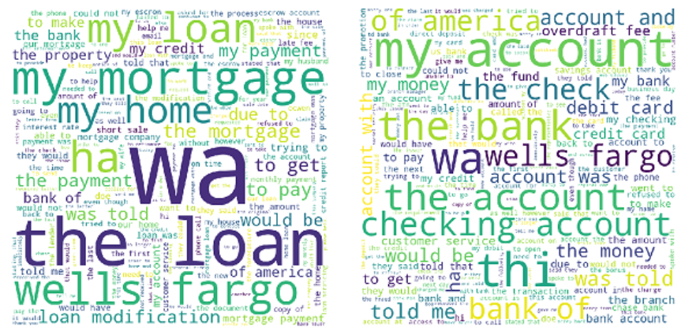
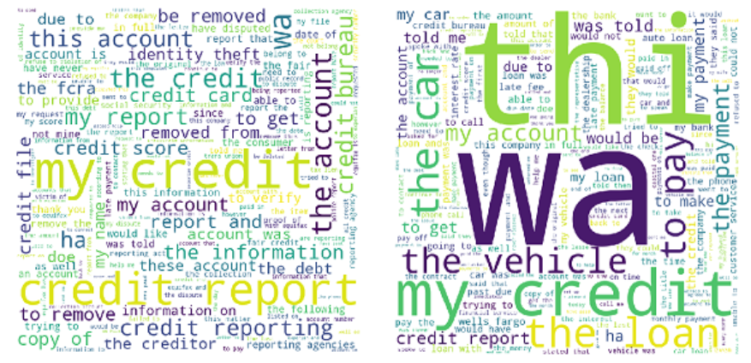
K-Means with improvements: T-SNE
Narrative and Product

Slide 31
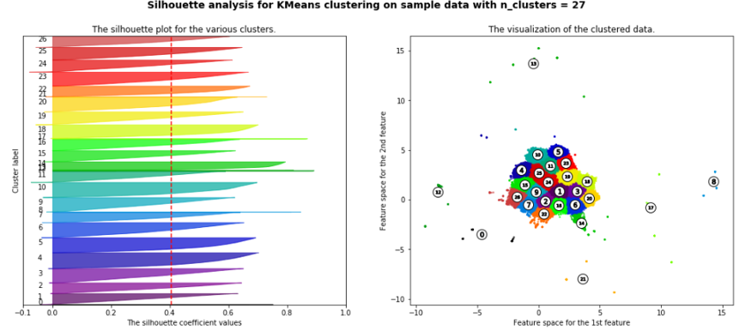
K-Means with improvements: UMAP
Narrative only

Slide 32
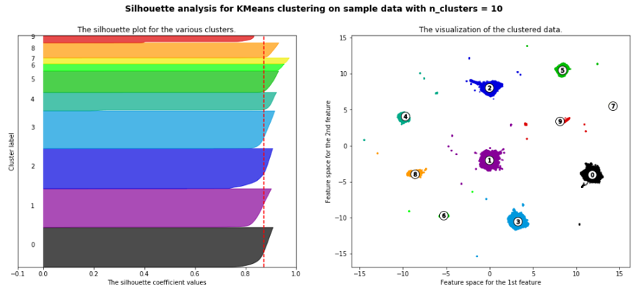
K-Means with improvements: UMAP
Narrative and Product

Slide 33
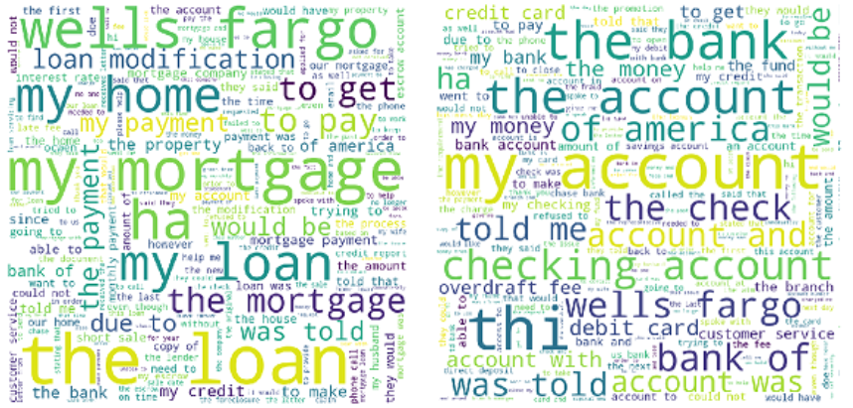
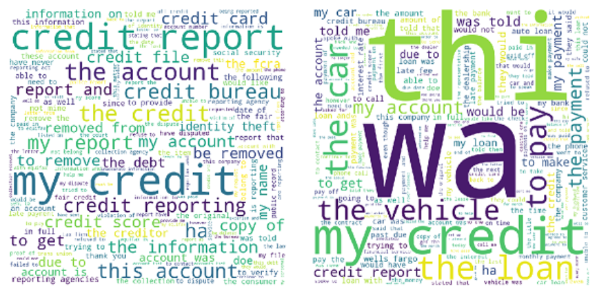
K-Means with improvements: UMAP
Narrative and Product

Slide 34
Sprint 3: LDA and BERT
Additional pre-processing
Unsupervised Learning Algorithm (Topic Modelling): LDA
Supervised Learning Algorithm (Deep Neural Network): BERT

Slide 35
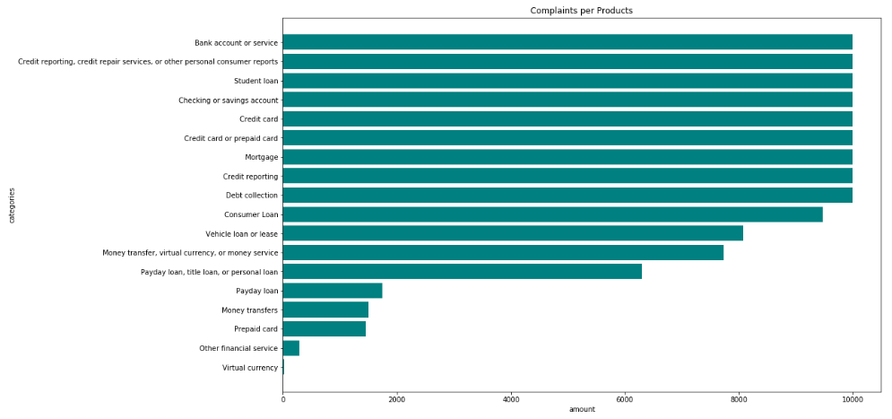
Additional pre-processing
For LDA
Stemming with PorterStemmer instead of Lemmatization
Additional balancing
Remove additional stop words
Common English words;
State names;
Other frequent words that add little to no value to context.
Word embedding with Doc2Vec

Slide 36
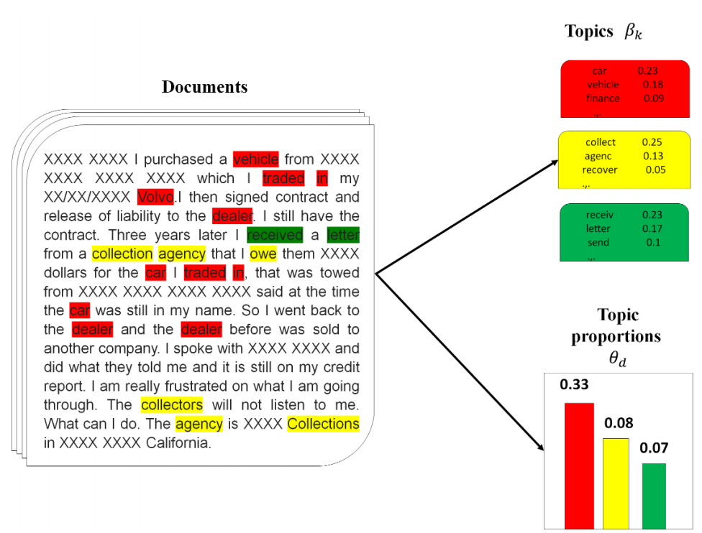
Latent Dirichlet Allocation (LDA)
Topic modelling algorithm (unsupervised learning)
Gensim library
Two main inputs for the model:
Dictionary (id2word)
Corpus
Topic smoothing parameter & Word/term smoothing parameter
→ Blei et al. give suggestions.
Find optimal number of topics
3 versions:
balanced data set
balanced data set (w/ more stop words removed)
Imbalanced data set (as an experiment)
Source: Bastani et al.

Slide 37
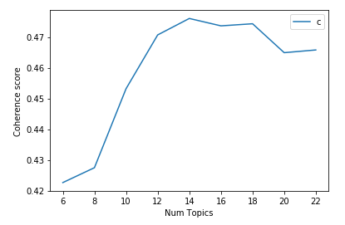
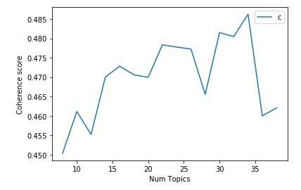
Coherence Score
Coherence Score (balanced version)
Coherence Score (balanced version w/ more stop words)
Observation:
Select topics value (k) that marks end of rapid growth in
topic coherence; before flattening.

Slide 38
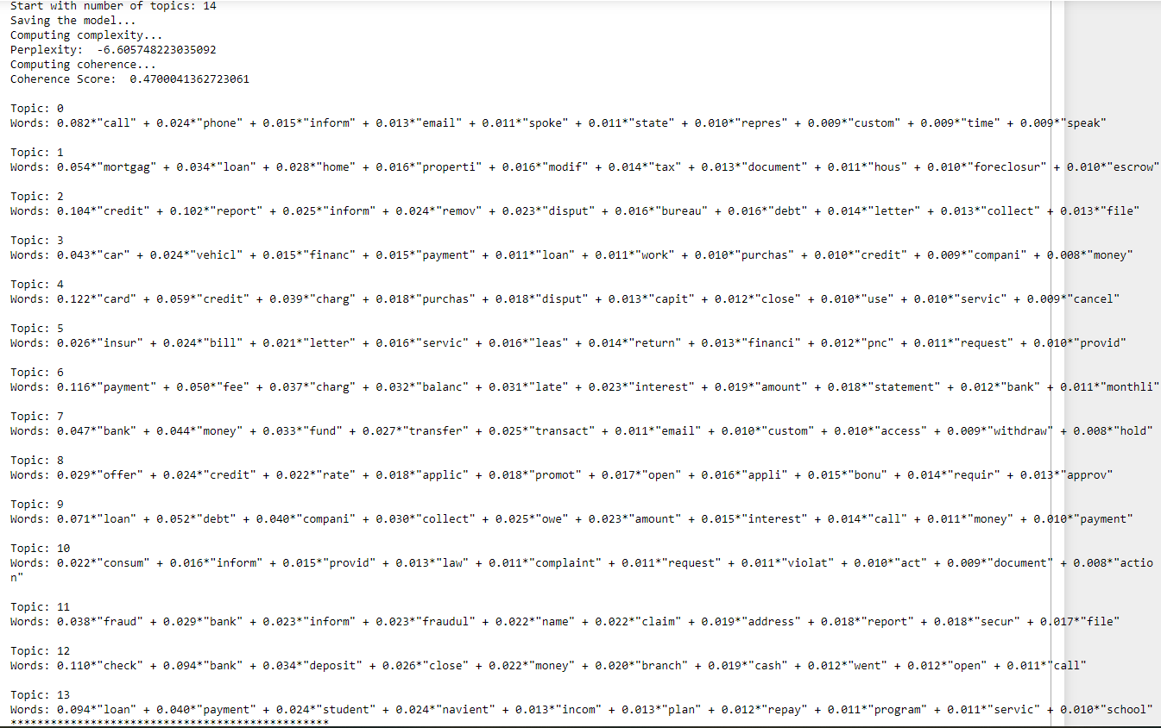
Topics detected by LDA
Field Expert
required

Slide 39
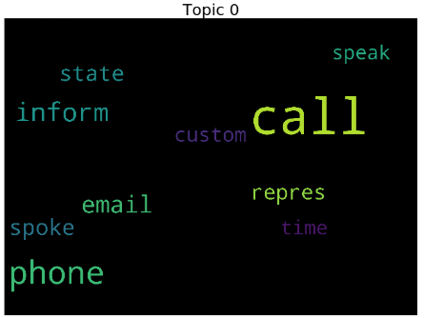
Word clouds for k = 14
Example topics:
Communications; customer support

Slide 40
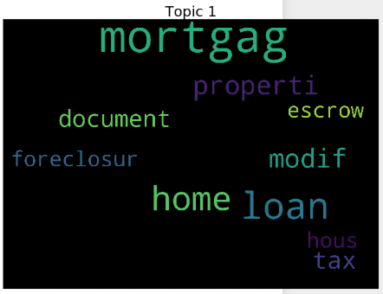
Word clouds for k = 14
Example topics:
Housing or property / mortgages

Slide 41
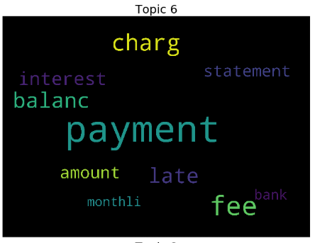
Word clouds for k = 14
Example topics:
Bank payments

Slide 42
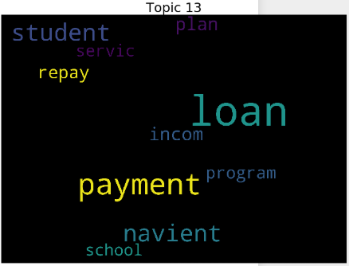
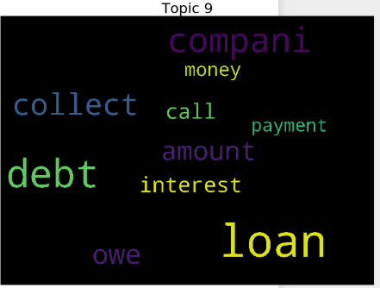
Word clouds for k = 14
Example topics:
General loans & debt related

Slide 43
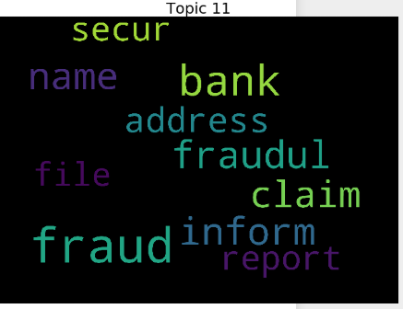
Word clouds for k = 14
Example topics:
Fraud

Slide 44
Word clouds for k = 14
Example topics:
Student loans

Slide 45
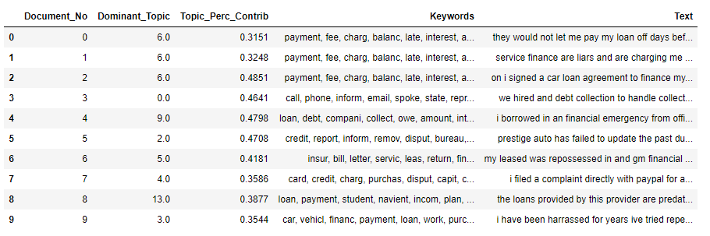
Dominant topic & its contribution

Slide 46
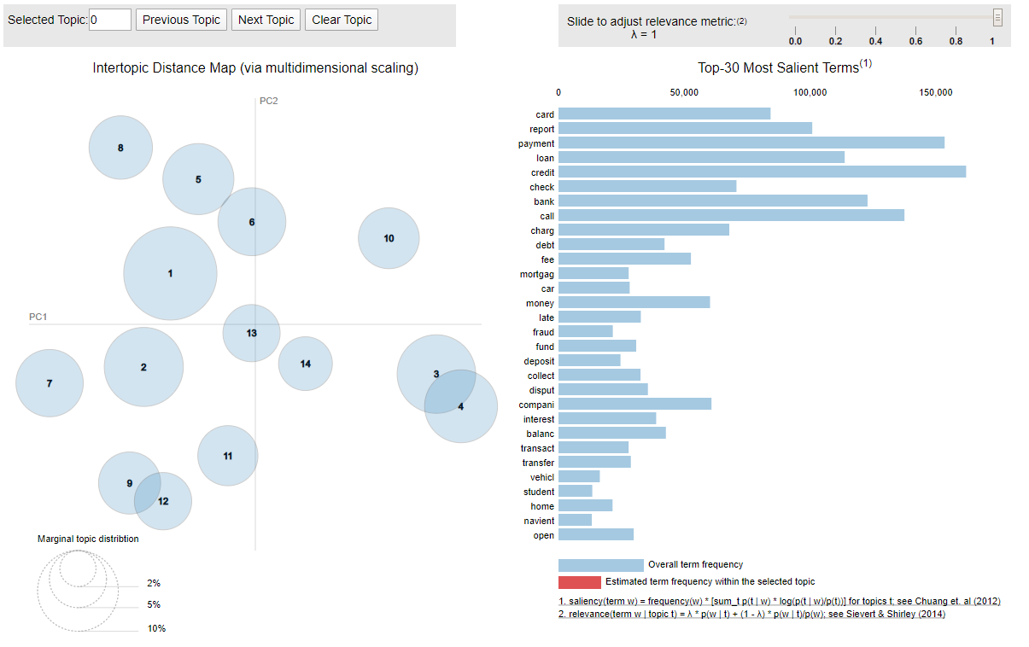
Visualisation using PyLDAvis
Increase in k:
higher chance in topic overlap;
small sized bubbles in one region
We desire:
balance between k & overlap
large, scattered,
non-overlapping bubbles

Slide 47
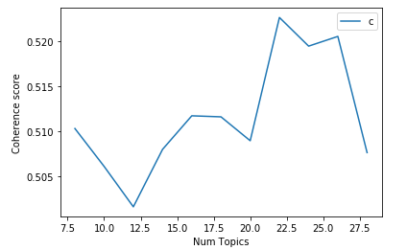
Imbalanced data set
Coherence Score (imbalanced version w/ more stop words)

Slide 48



Imbalanced data set
k = 22
k = 8
k = 20

Slide 49
Conclusion
LDA model, balanced data set, with more stop words removed
Improvement over original LDA model with just a balanced data set.
k = 14 yields fairly well distributed topics.
LDA model, imbalanced data set, with more stop words removed
Much worse than previous two.

Slide 50
Future work
Remove even more stop words?
Attempt t-SNE
Tweak certain parameters of the model, such as alpha & eta, iterations, passes
Use different scoring measure for the model (e.g. U mass instead of c_v)
Use ‘Mallet’ as a wrapper:
Gensim provides wrapper to implement Mallet’s LDA
Could potentially increase c_v

Slide 51

BERT
Bidirectional Encoder Representations from Transformers (Devlin et al., 2019)
Deep neural network based technique for NLP
Word embeddings
Pre-trained on:
Roughly 10,000 books
English Wikipedia
Fine-tune this model → Additional output layer

Slide 52


BERT
Language model can learn from context based on surrounding words
→ Contextual model
Large & Base (~ 30K ‘words’)
We can use BERT for:
Classification (supervised learning)
Named Entity Recognition
Part of Speech Tagging
Question Answering
Hugging Face implementation of BERT using PyTorch
Google Colab

Slide 53

BERT’s vocabulary
Distribution of word token length

Slide 54


BERT’s vocabulary
Misspellings? → It would not appear so.
Contractions? → No. BERT’s tokenizer separates words that contain symbols/punctuation
Names? → Use Gutenberg’s list of names
Numbers? Yes, although half of them appear to be dates.
Symbols? Yes.
New words?

Slide 55

Fine-tuning BERT
BERT has its own Tokenizer due to special tags, such as [CLS] and [SEP].
Additional pre-processing: product consolidation & more balancing
E.g. consolidate “Virtual currency” into “Money transfer, virtual currency, or money service.”
18 products → 13 products
Still questionable

Slide 56

Fine-tuning BERT
BERT has its own Tokenizer due to special tags, such as [CLS] and [SEP].
No special tokens,
because this is
a fully cleaned
complaint,
i.e. without
punctuation

Slide 57
Fine-tuning BERT
Additional pre-processing: data set cleaning → 3 versions
Version 1: Fully cleaned (lowercasing, removing URLs, removing censored words (XXXX), removing dates, removing all symbols, removing numbers, normalising spaces)
Version 2: Nearly fully cleaned (lowercasing, removing URLs, removing censored words (XXXX), removing symbols except for punctuation, removing decimal point in number, normalising spaces)
Version 3: Partially cleaned (basic cleaning: lowercasing, removing URLs, removing newlines & tabs, normalising spaces)

Slide 58

Original narrative

Slide 59

Version 1: fully cleaned

Slide 60

Version 2: nearly fully cleaned

Slide 61

Version 3: partially cleaned

Slide 62
Too many words
BERT: max sequence length (i.e. max. tokens or words per complaints) = 512
Sequence length for all complaints must be the same. → Use padding [PAD]
Use chunking or summerization if you want > 512
Idea: complaint conveys sufficient information in set sequence length
Truncation strategy:
Tokenize text
Encode
Truncate to desired length

Slide 63



Too many words
Version 1: fully cleaned
Version 2: nearly fully cleaned
Version 3: partially cleaned
Visually see how many complaints are affected by truncation.

Slide 64

Too many words
Affected complaints per product
Version 1 data set
Most affected: mortgage

Slide 65

Attention masks
Tell BERT which tokens are actual words vs. padding ([PAD], represented as 0)

Slide 66

Data set split
80% training set, 10% validation set, 10% test set
Potential improvement: cross validation.

Slide 67
Other details
Convert data set variables to tensors
Use iterator to save memory and loop much faster
BertForSequenceClassification
Choose batch size (authors recommend 16 or 32)
We tried 2, 4, 8, 16 & 32.
Optimizer (authors recommend learning rate = 2e-5 & epsilon = 1e-8)
We did not fine tune these hyper parameters.
Epochs (authors recommend 2 to 4)
We chose 4.

Slide 68
Overview of runs
Version 1: 15 runs
Several runs with 40K complaints, instead of entire balanced data set (106K)
Yielded lower avg. model accuracy than data set with 106K, thus version 2 and 3 runs only contained the entire data set.

Slide 69

Run 1
2 batches, 1K complaints, sequence length 512

Slide 70

Run 2
4 batches, 1K complaints, sequence length 128 → Down!
Went down

Slide 71

Run 3
4 batches, 4K complaints, sequence length 128 → Up due to increase in complaints

Slide 72

Run 4
4 batches, 8K complaints, sequence length 128 → Up due to increase in complaints

Slide 73

Run 5
4 batches, 20K complaints, sequence length 128 → Up due to increase in complaints

Slide 74

Run 8
4 batches, 106K (all) complaints, sequence length 256

Slide 75

Run 8: confusion matrix
Confusion remains an issue in other versions too.

Slide 76

Run 8: training loss
Training loss below 0.5 for first time.

Slide 77
Runs 9-15
run 9) 8 batches, 40K complaints, sequence length 128: avg. accuracy 0.71
run 10) 8 batches, 106K (all) complaints, sequence length 128: avg. accuracy 0.74
run 11) 8 batches, 40K complaints, sequence length 256: avg. accuracy 0.74
run 12) 8 batches, 106K (all) complaints, sequence length 256: avg. accuracy 0.75
run 13) 16 batches, 106K (all) complaints, sequence length 128: avg. accuracy 0.74
run 14) 16 batches, 40K complaints, sequence length 256: avg. accuracy 0.72
run 15) 16 batches, 106K (all) complaints, sequence length 256: avg. accuracy 0.75
Observations:
More complaints yield slightly higher results.
Increase in batch size =/= better performance, despite intuition it might.

Slide 78
Version 2 runs (nearly fully cleaned)
run 1) 8 batches, 106K (all) complaints, sequence length 128: avg. accuracy 0.75
run 2) 8 batches, 106K (all) complaints, sequence length 256: avg. accuracy 0.76
run 3) 16 batches, 106K (all) complaints, sequence length 128: avg. accuracy 0.75
run 4) 16 batches, 106K (all) complaints, sequence length 256: avg. accuracy 0.77
Observations:
Steady accuracy, though training loss between epochs is lower than version 1.
Models take less time to run.
Increase in batch size == slightly better result, but negligible.

Slide 79
Version 3 runs (partially cleaned)
run 1) 8 batches, 106K (all) complaints, sequence length 128: avg. accuracy 0.77
run 2) 8 batches, 106K (all) complaints, sequence length 256: avg. accuracy 0.78
run 3) 16 batches, 106K (all) complaints, sequence length 128: avg. accuracy 0.77
run 4) 16 batches, 106K (all) complaints, sequence length 256: avg. accuracy 0.79
run 5) 32 batches, 106K (all) complaints, sequence length 256: avg. accuracy 0.78
Run 5 substantially faster than Run 4
Observations:
Better results than version 1 and 2.
Models take less time to run.
It appears removing words (tokens) is bad for BERT’s understanding of context.
Training loss between epochs even lower than version 2.

Slide 80

Version 3, run 5
32 batches, 106K (all) complaints, sequence length 256

Slide 81

Version 3, run 5
32 batches, 106K (all) complaints, sequence length 256
Consolidate even more products?
Not if distinction is required between credit & prepaid cards.

Slide 82

Version 3, run 5
32 batches, 106K (all) complaints, sequence length 256
→ More epochs?

Slide 83

Version 3, run 6
32 batches, 106K (all) complaints, sequence length 256, epochs = 7
Same issues as before.

Slide 84

Version 3, run 6
32 batches, 106K (all) complaints, sequence length 256, epochs = 7
More epochs =/= model fine-tuning improvements

Slide 85

Version 3, run 6
32 batches, 106K (all) complaints, sequence length 256, epochs = 7

Slide 86
Conclusion
Batch size does not necessarily improve model, but does make fine-tuning faster.
Sequence length of complaint (128 → 256): improves avg. model accuracy only slightly
BERT does not need as many words to understand complaint.
Hypothesis was: fully cleaned version (1) > version 2 & 3
Proven wrong! Version 3 (with censored data (XXXX)) is superior. Potentially due to sentence structure.
Could potentially push to 80+ % avg. model accuracy, if loans are grouped as one product, or a better distinction can be made/added (more information for BERT).

Slide 87

Conclusion
BERT is indeed much better when compared to RF (0.69) or SVM (0.58) in terms of avg. model accuracy.
Narrative only
Additional experiment: more epochs. Improvement? → Not really.
Large BERT → needs more GPU memory

Slide 88

Motivated to keep ‘learning’!

